Slide 1
Title :- Online Dairy Management System
PROJECT

Slide 2
GROUP INFORMATION
Ishan Singh | 1JS18CS064 | ishan.1999@gmail.com
Kushagra Agarwal | 1JS18CS069 | kush121199@gmail.com

Slide 3
INTRODUCTION
This system is designed for small medium enterprise. The chosen methodology for this project is throwaway prototyping methodology. This is because majority of the targeted user do not have the experience in using computerized system as they used traditional ordering system previously.
This projects provides a gateway for end users in need of dairy products and local companies which can deliver product easily to these local customers.
This project provides two interfaces, one for admin, other for end user.

Slide 4
OBJECTIVE
The main objective is to provide easy home delivery of dairy products anywhere, anytime and at an affordable price.

Slide 5
PROPOSED MODEL

Slide 6
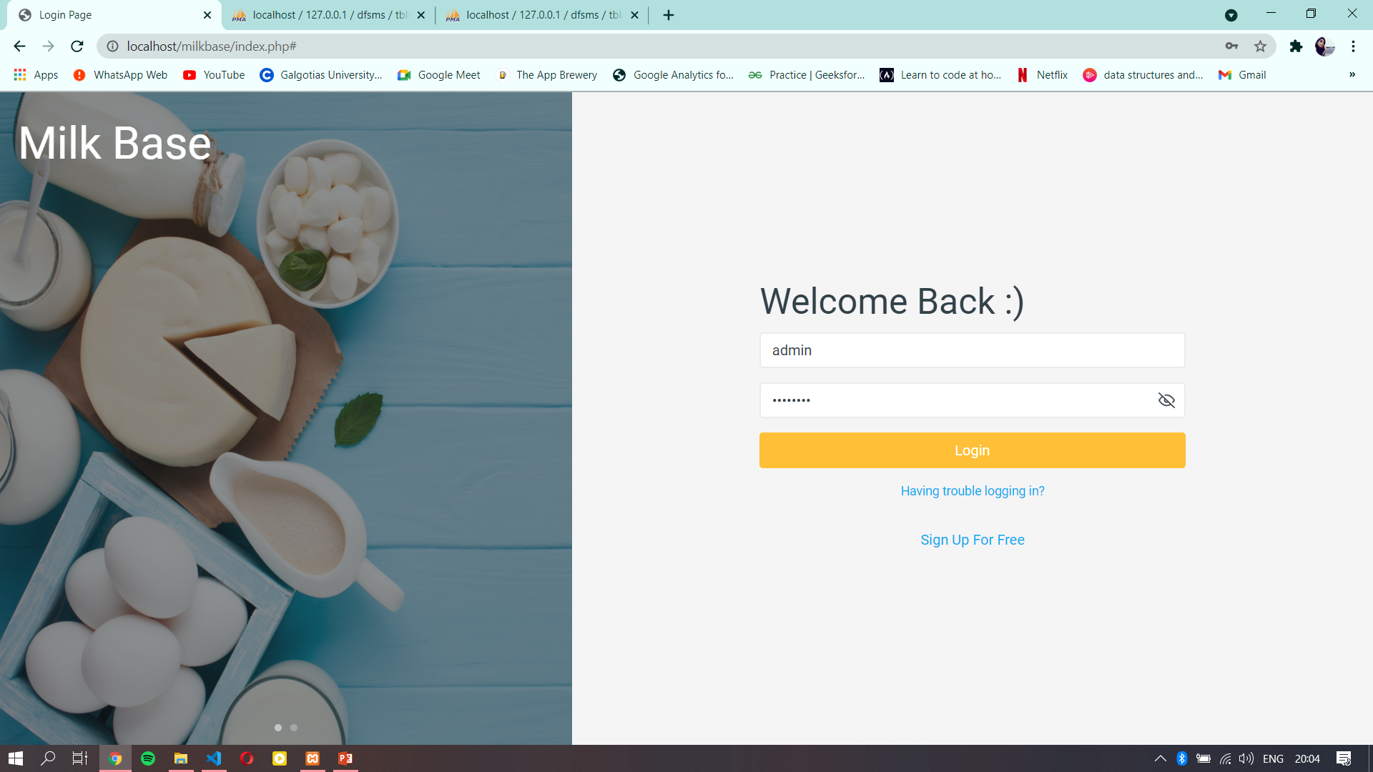

Slide 7
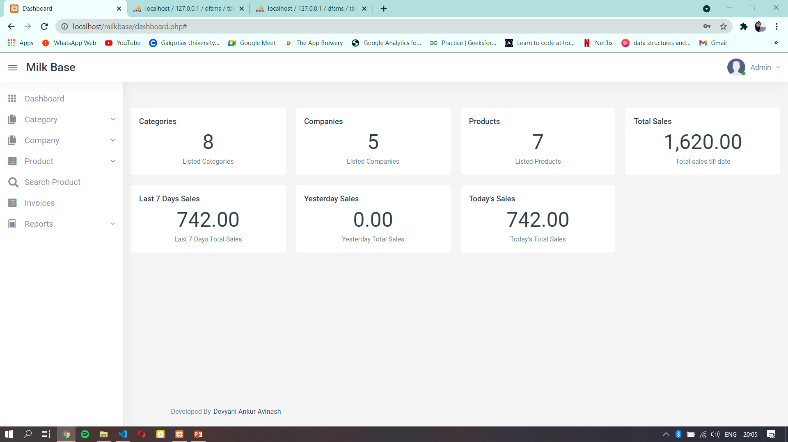

Slide 8
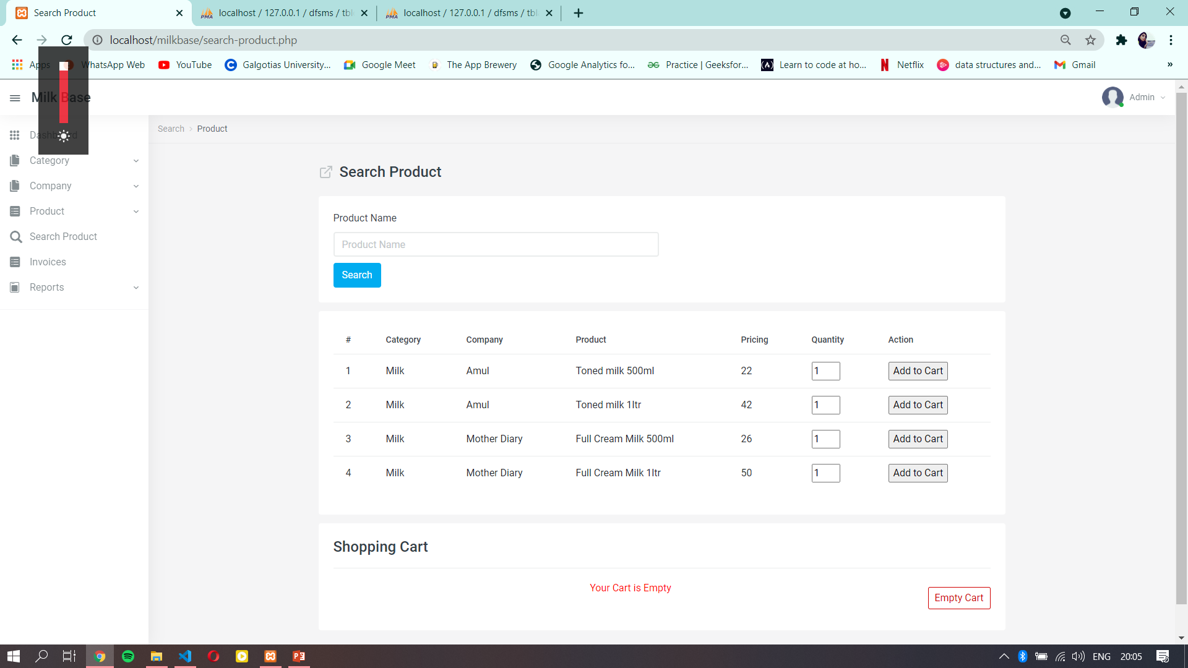

Slide 9
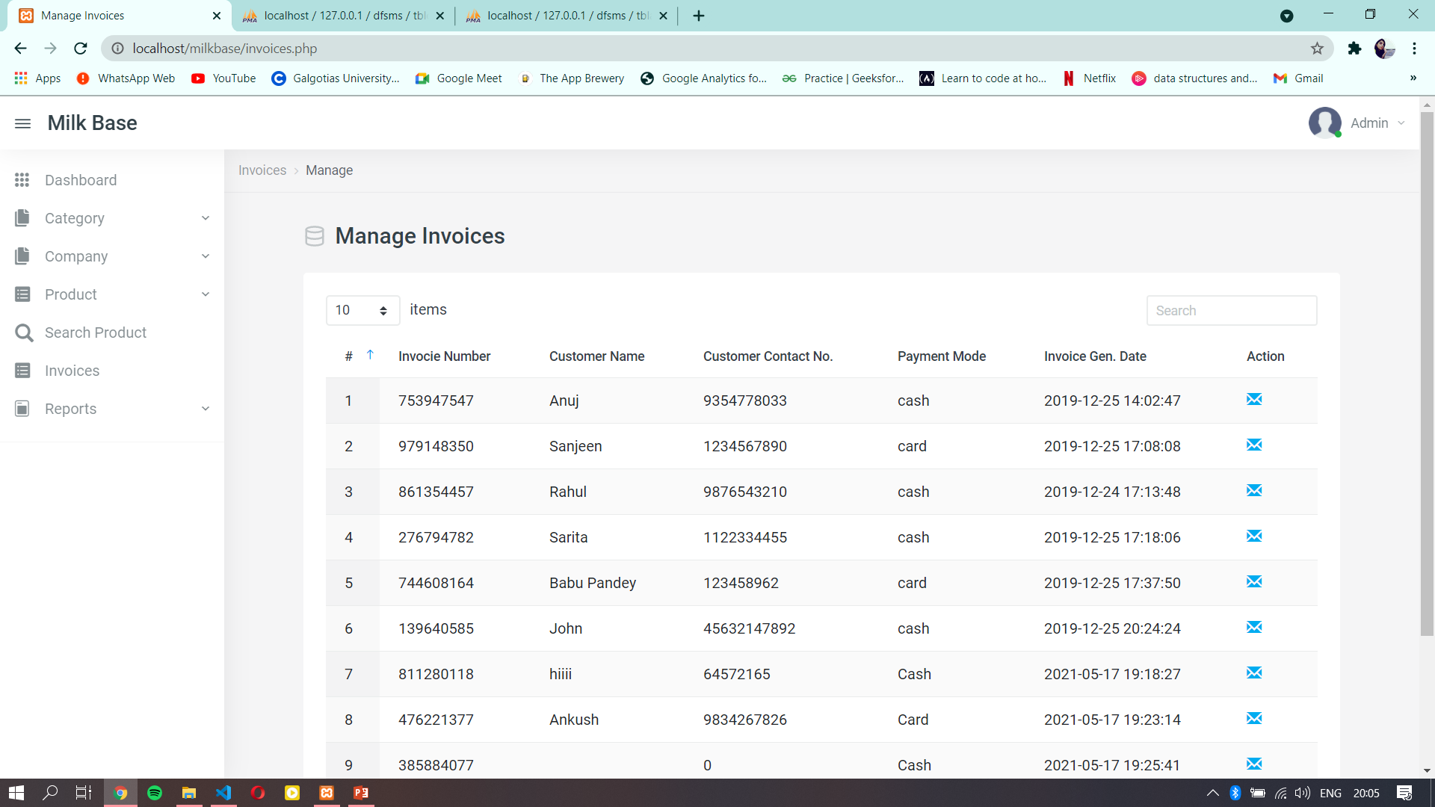

Slide 10
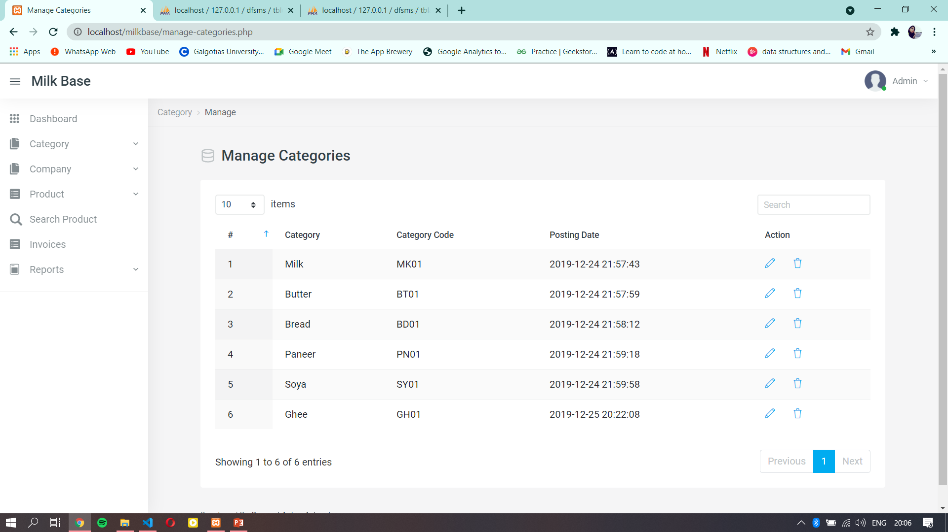

Slide 11
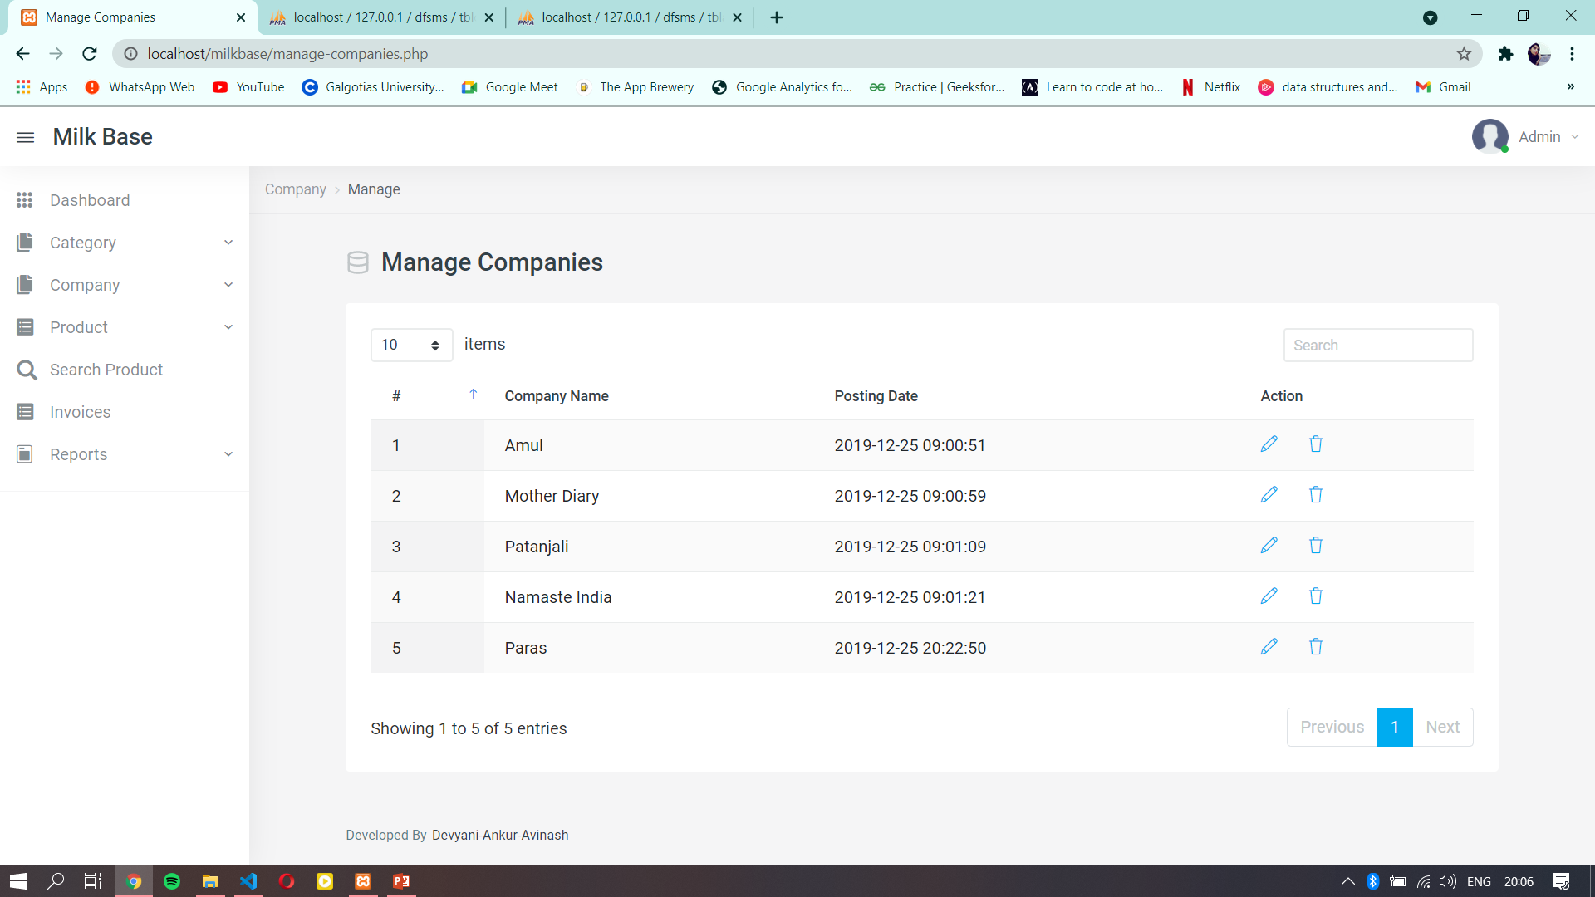

Slide 12
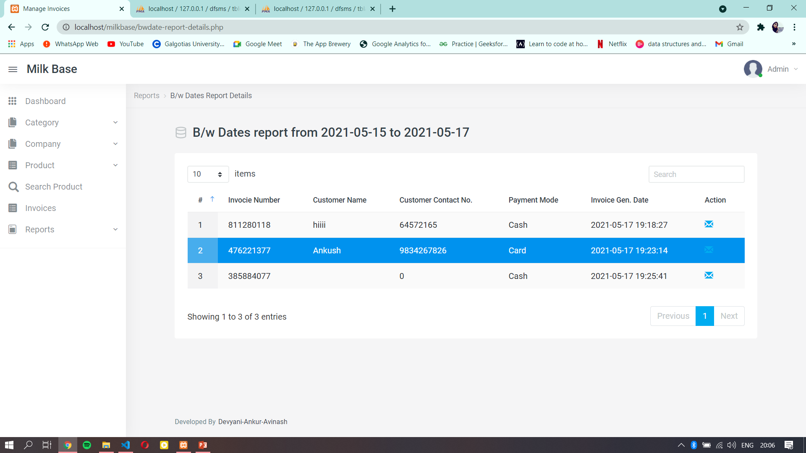

Slide 13
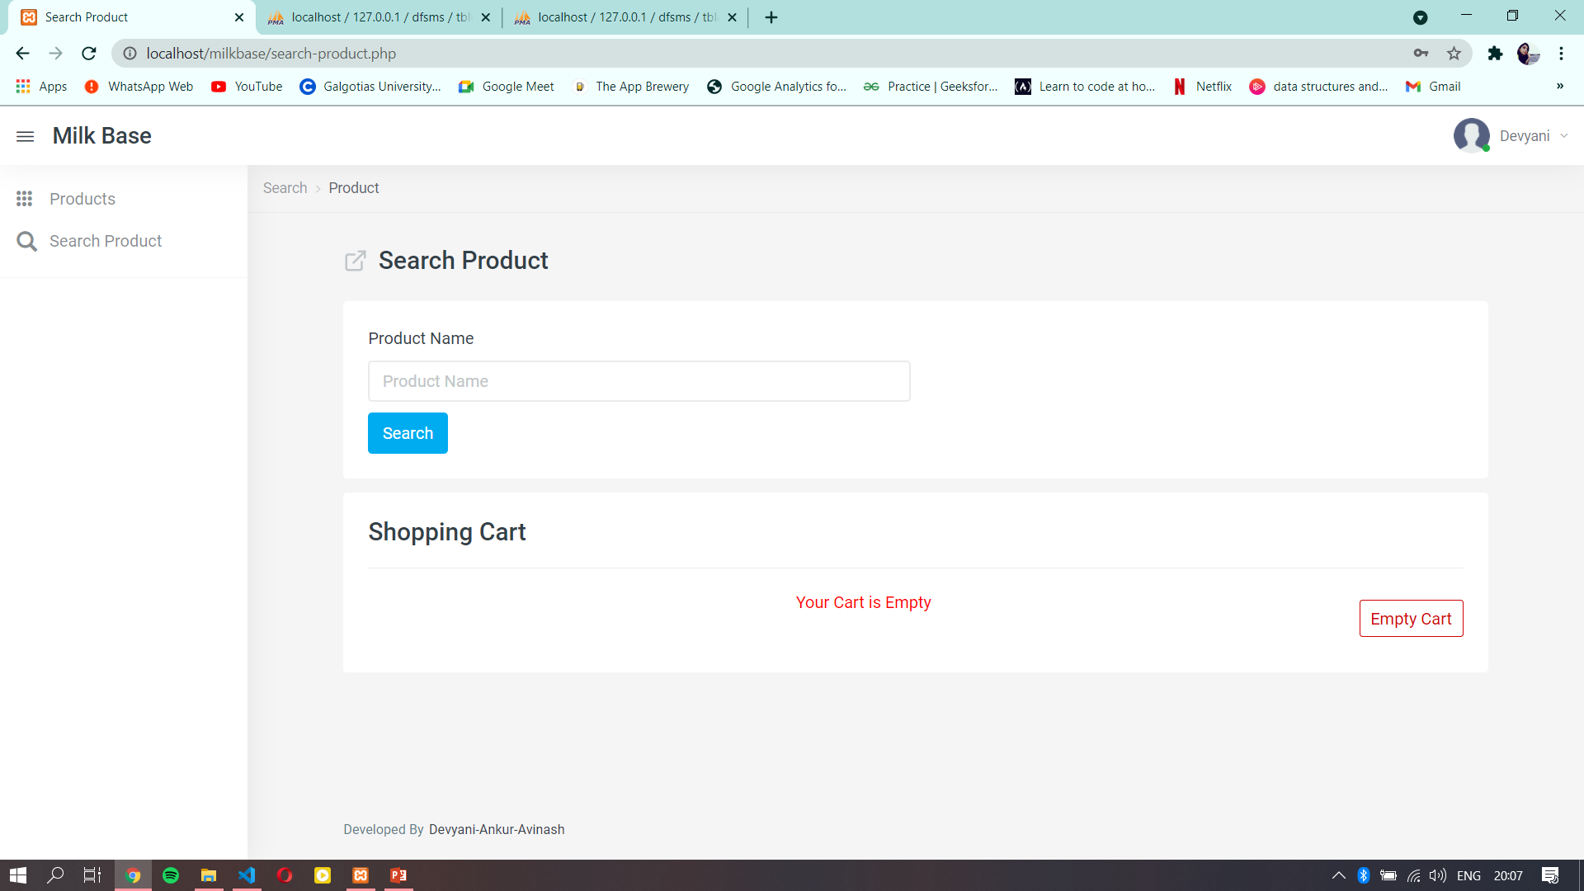

Slide 14
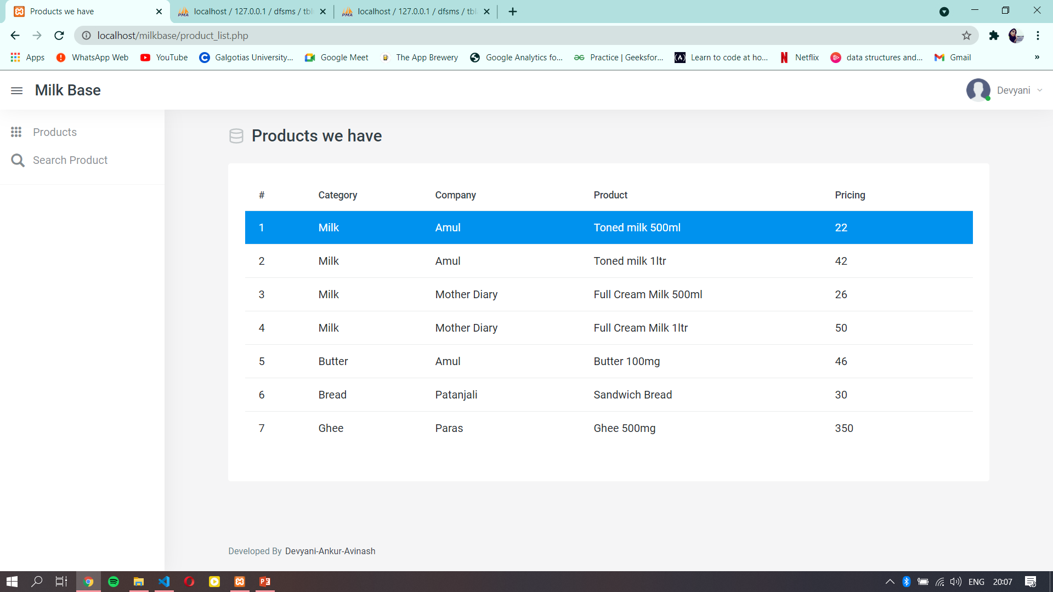

Slide 15
REFERENCES
Google
YouTube
Wikipedia
Geeks For Geeks
Stack Overflow

